Slide 1
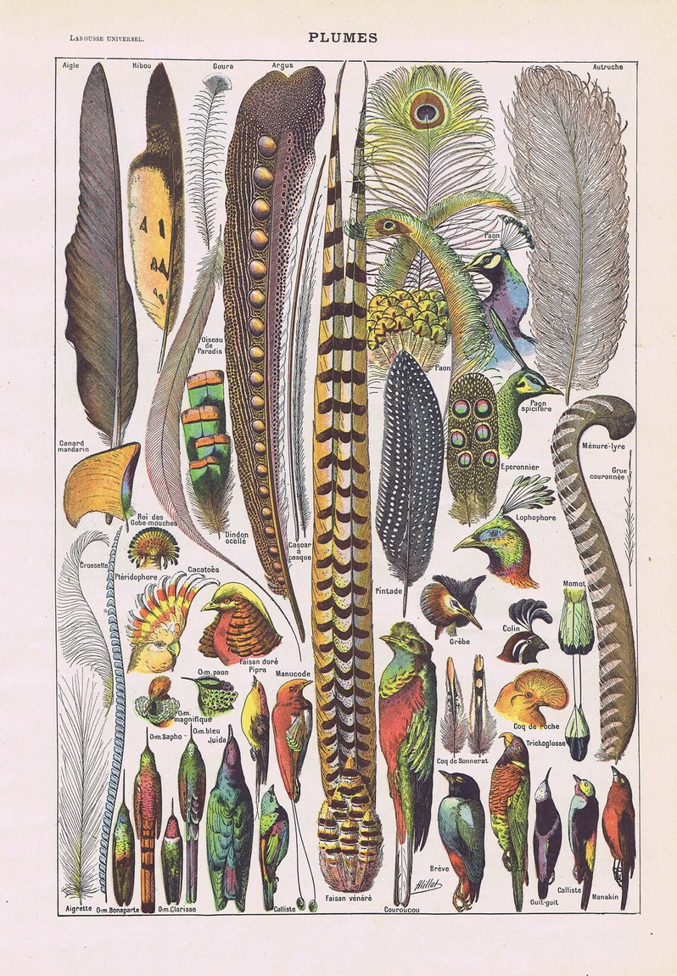
MSc Wildlife Masters Dissertation - Mock Proposal
Investigating Links between the Vocal Network & Participation Network in Mixed-Species Bird Flocks in the Eastern Himalayas
Ronith Urs
Feathers by Adolphe Millot

Slide 2
Analyses & Expected Results
Questions
5
Study Area & Design
4
The Study
3
The Literature
2
1

Slide 3
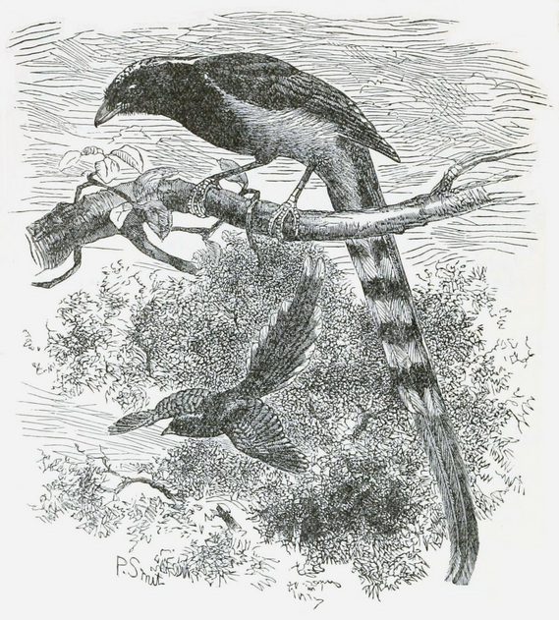
Why do Birds form Mixed Species Flocks?
Increased foraging efficiency
Feeding on arthropods flushed by other birds (Winterbottom 1943)
Copying foraging locations (Krebs 1973)
Avoiding previously exploited areas (Beauchamp 2005)
Decreased predation pressure
Selfish Herd Effect: Reduced risk in relation to the position of other group members (Hamilton 1971)
Dilution Effect: Reduced probability of being singled out by a predator (Foster & Treherne 1981)
Encounter Effect: Reduced probability of being encountered by a predator (Inman & Krebs 1987)
Many-eyes Effect: Increased probability of a predator being detected (Pulliam 1973)
W T Blanford
1

Slide 4
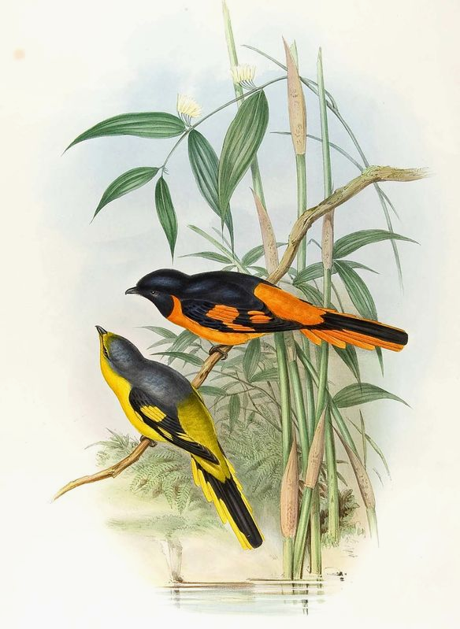
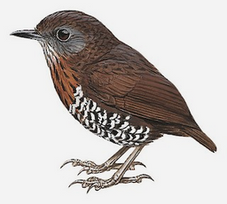
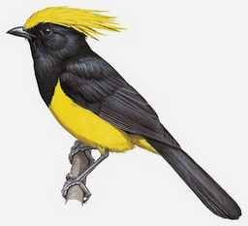

The Concept of Nuclearity in Flocks
Although the term Nuclearity is loosely defined, it’s based on the idea that Mixed Species Flock participants play different (and often unequal) roles in flock formation and maintenance
Is nuclearity a dichotomy or a spectrum? Why is it important that we look at it as a spectrum from non-nuclear to nuclear?
For the purpose of the study, we define nuclearity in MSFs as the number of inter-species associations (via Srinivasan et al. 2010)
Increase in Nuclearity
1
John Gould

Slide 5
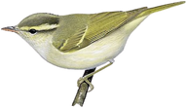
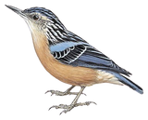
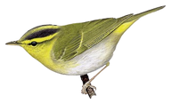
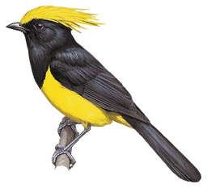
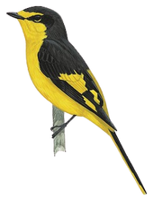
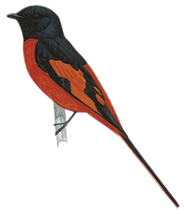
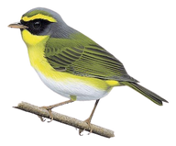
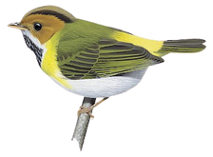
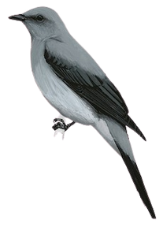
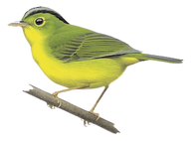
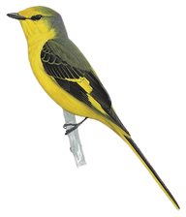
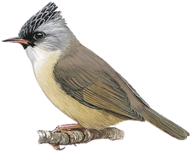
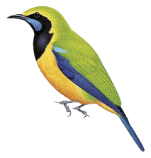
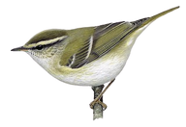
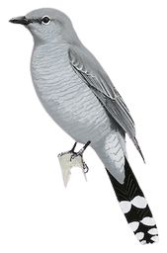
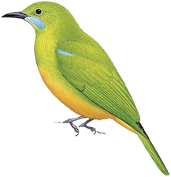
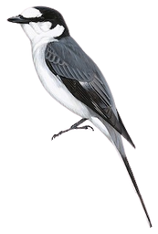
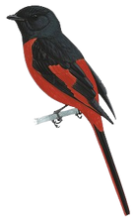
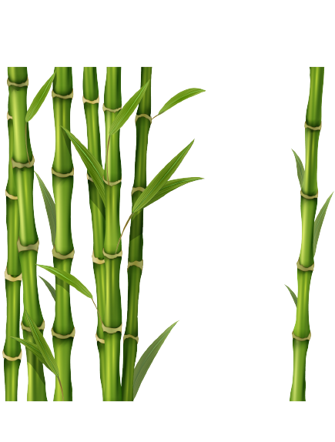
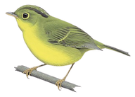
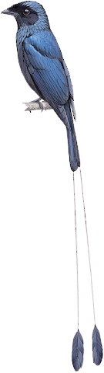
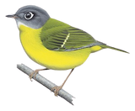
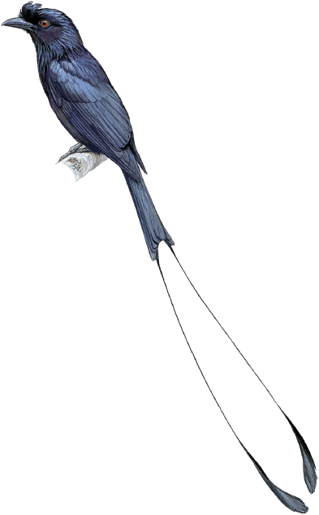
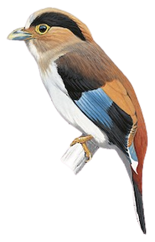
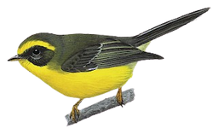
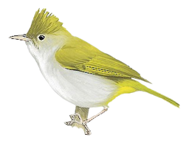
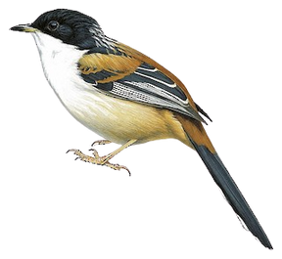
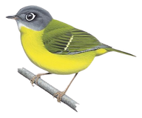
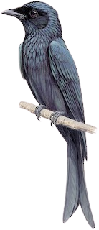
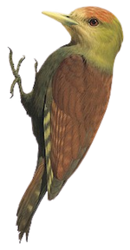
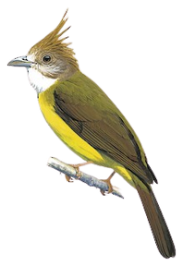
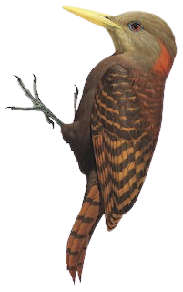
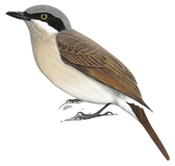
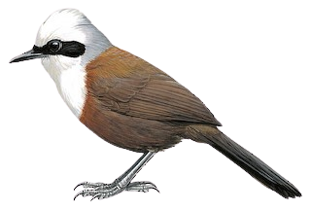
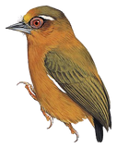
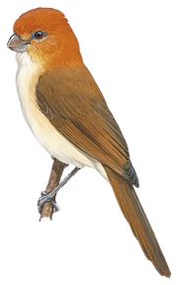
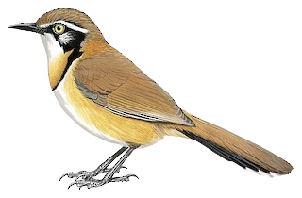
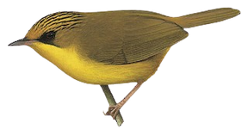
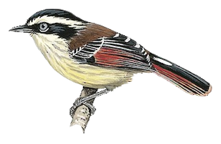
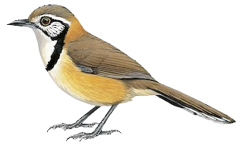
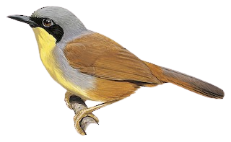
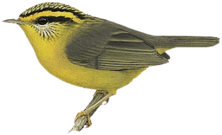
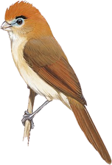
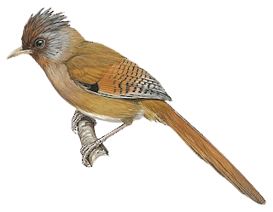
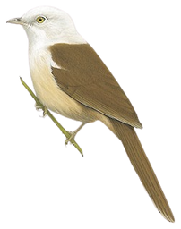









Illustrations via BOTW

Slide 6
Large-bodied undergrowth Flocks
Illustrations via BOTW

Slide 7
Canopy Flocks
Illustrations via BOTW

Slide 8
Small-bodied undergrowth Flocks
Illustrations via BOTW

Slide 9
Bamboo Flocks
Illustrations via BOTW

Slide 10

Linking Vocal Participation & Nuclearity
I.
II.
III.
How does Vocal Participation relate to Nuclearity in Mixed Species Flocks?
Are species that vocalize more actively, also more nuclear?
Is vocal participation influenced by behavioral traits, such as:
Body size
Foraging method (gleaners / salliers / hoverers)
Does the relationship between vocal participation and nuclearity hold true across different flock types?
Large-bodied Undergrowth Flocks
Small-bodied Undergrowth Flocks
Canopy Flocks
Bamboo Flocks
2
John Gould

Slide 11

How would this study add to our Understanding of Flocks?
A number of papers have either hypothesized or anecdotally mentioned that vocal activity may increase with nuclearity, but it has not been quantified (Pagani‐Núñez et al. 2018)
Builds on work done by Srinivasan et al. (2010) in the region, by attempting to understand nuclearity through the lens of vocal activity
Not too many studies on vocal behavior in flocks from South Asia
2
John Gerrard Keulemans

Slide 12


Study Area
Sampling will take place in low to mid-elevation forest in Namdapha National Park, Changlang District, Arunachal Pradesh
The ideal sampling period begins in early November and end in March, before the rain sets in and birds begin leaving MSFs to breed
3
namdaphatigerreserve.com
Chetry et al. (2003)

Slide 13

Study Design & Methods
As part of the sampling strategy, I plan to:
Lay down transects to follow and record mixed flocks in low to mid elevation forests across multiple sites in Namdapha NP
Note GPS points for transects & points at which flocks were encountered
Note species and their corresponding numbers in each flock
3
John Gould

Slide 14

Species 1 Vocalizing
spectrogram via Zhang et al. (2022)
Species 2 Vocalizing
v
T
V =
____
4
Vocal activity of Species V = Vocal period of Species v / Total length of the recording T

Slide 15

Accounting for Abundance in the Vocal & Participation Networks
Vocal activity of a species in a flock increases with the number of individuals, although the relationship is non-linear
Nuclearity is also positively correlated with abundance, where species that are more common are more likely to form more interspecific connections by virtue of their sheer numbers.
4
John Gould

Slide 16

Abundance in the Vocal Network
4
Meaux et al. 2021

Slide 17
Initial Increase in the Number of Individuals
4
Meaux et al. 2021

Slide 18
Initial Increase in the Number of Individuals
>
Subsequent Increase in the Number of Individuals
4
Meaux et al. 2021

Slide 19

Abundance in the Participation Network
Conduct point counts in addition to flock data to determine the absolute abundances of a species
Use abundance data for each flocking species to simulate null flocks to see if the actual number of interspecific associations are greater or lesser than expected by chance (Srinivasan et al. 2010)
Use the null flocks to positively or negatively weight nuclearity scores for each flocking species
4
John Gould

Slide 20

Expected Results
We expect Vocal participation to be positively correlated with the participation network: with the increase in number of interspecific associations, vocal activity in flocks is also expected to increase.
The relationship between vocal and participation networks should remain constant across flock types
Body size is expected to have a negative effect on vocal activity (from Abhijith’s unpublished work), but since birds tend to organize themselves in flocks of similar body size (Colorado & Rodewald 2014, Srinivasan et al. 2012), the effect of this confound is minimized
Foraging method may or may not have an effect on nuclearity & vocal activity since sallier species play a role in flock initiation and cohesion despite being non-gregarious (Goodale & Kotagama 2005)
4
John Gould

Slide 21

Caveats & Considerations
Need to pay close attention to calling contexts and make sure calling contexts remain the same throughout
There have been other methods used to measure nuclearity, which may yield different results (Mangini et al. 2023)
Need to take into account call structure and how it influences our calculation of vocal activity
4
J. Gould and H. C. Richter

Slide 22

Measuring Vocal Participation: Call Structure
+
+
+
XC826043: Blyth's Reed Warbler (Acrocephalus dumetorum) by FlackoWeasel
4

Slide 23

+
+
XC656148: Blyth's Reed Warbler (Acrocephalus dumetorum) by Gerard Kenter
4

Slide 24

XC214012: Blyth's Reed Warbler (Acrocephalus dumetorum) by Pankaj Lad
4

Slide 25

Workplan

Slide 26

Acknowledgements
Dr. Anand Krishnan, JNCASR
Dr. Umesh Srinivasan, CES-IISc
Dr. Eben Goodale, XJTLU
Abhijith A V, JNCASR
Dr. Rohit Naniwadekar, NCF
Uddipana Kalita, NCBS
Shashank Dalvi, NCBS
Chintan Sheth, NCBS
Dr. Trevor Price, UChicago
Dr. Sandeep Pulla, LTEO
Sidharth Srinivasan, NCF
Dr. Vivek Ramachandran, NCBS
Dr. Jayashree Ratnam, NCBS
All my wonderful, beautiful, lovely batchmates
John Gould

Slide 27

References
Winterbottom, J. M. 1943. On woodland bird parties in northern Rhodesia. Ibis, 84, 437–442.
Krebs, J. R. 1973. Social learning and the adaptive significance of mixed-species flocks of chickadees. Canadian Journal of Zoology, 51, 1275–1288.
Beauchamp, G. 2005. Does group foraging promote efficient exploitation of resources? Oikos, 111, 403–407, doi:10.1111/j.0030-1299.2005.14136.x.
Hamilton, W. D. 1971. Geometry for the selfish herd. Journal of Theoretical Biology, 31, 295–311.
Foster, W. A. & Treherne, J. E. 1981. Evidence for the dilution effect in the selfish herd from fish predation on a marine insect. Nature, 293, 466–467, doi:10.1038/ 293466a0.
Inman, A. J. & Krebs, J. 1987. Predation and group living. Trends in Ecology & Evolution, 2, 31–32, doi:10.1016/0169-5347(87)90093-0
Pulliam, H. R. 1973. On the advantages of flocking. Journal of Theoretical Biology, 38, 419–422.
Srinivasan, U., Raza, R.H. and Quader, S. (2010), The nuclear question: rethinking species importance in multi-species animal groups. Journal of Animal Ecology, 79: 948-954. https://doi.org/10.1111/j.1365-2656.2010.01707.x
Srinivasan, U., Raza, R. H., & Quader, S. (2012). Patterns of species participation across multiple mixed-species flock types in a tropical forest in northeastern India. Journal of Natural History, 46(43-44), 2749-2762.
Pagani‐Núñez, E., Xia, X., Beauchamp, G., He, R., Husson, J. H., Liang, D., & Goodale, E. (2018). Are vocal characteristics related to leadership patterns in mixed‐species bird flocks?. Journal of Avian Biology, 49(5), jav-01674.
Colorado, Gabriel J., and Amanda D. Rodewald. "Assembly patterns of mixed‐species avian flocks in the Andes." Journal of Animal Ecology 84.2 (2015): 386-395.
Goodale, Eben, and Sarath W. Kotagama. "Alarm calling in Sri Lankan mixed-species bird flocks." The Auk 122.1 (2005): 108-120.
Mangini, G. Giselle, et al. "A classification scheme for mixed-species bird flocks." Philosophical Transactions of the Royal Society B 378.1878 (2023): 20220100.
John Gould

Slide 28

Questions!

